Slide 1
Introduction to VAPT
VAPT

Slide 2
Vulnerability Assessment and Penetration Testing (VAPT)
V --> Vulnerability :
A --> Assessment :
P --> Penetration:
T --> Testing:
The LOOPHOLES ,security misconfigurations which can cause an attacker to get inside a network or website or ways which help an attacker to intrude in the systems.
Analysing the vulnerability and scanning the vulnerability onto how much it could cause damage to the victim.
When you get the vulnerability and is accessed, a report is generated and through that further exploitation or intrusion is done this is known as penetration .
When a person is penetrating it requires several procedures or attacks to penetrate this is done through this testing phase.

Slide 3
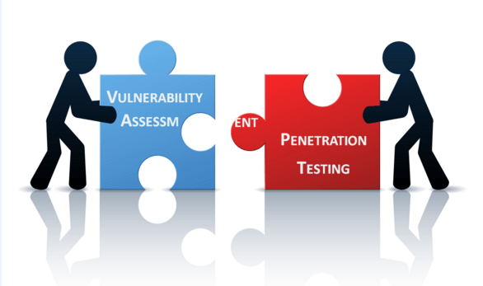
VAPT (Vulnerability Assessment Penetration Testing)
VAPT Service is the combination of two different Security Services one is Vulnerability Assessment (VA) & Penetration Testing (PT).
The tests have different powers and are often shared to achieve a more complete vulnerability analysis.
Both Services have their own area for securing your network & application.

Slide 4
VAPT
Vulnerability Assessment | Penetration Test
Vulnerability Assessment Tools discover which vulnerabilities are present, but they do not differentiate between flaws that can be exploited to cause damage and those that cannot. Vulnerability scanners alert companies to the pre-existing flaws in their code and where they are located. | Penetration tests find exploitable flaws and measure the severity of each. Penetration tests attempt to exploit the vulnerabilities in a system to determine whether unauthorized access or other malicious activity is possible and identify which flaws pose a threat to the application. A penetration test is meant to show how damaging a flaw could be in a real attack rather than find every flaw in a system.
Together, Vulnerability Assessment and Penetration Testing Tools provide a detailed picture of the flaws that exist in an application and the risks associated with those flaws.

Slide 5
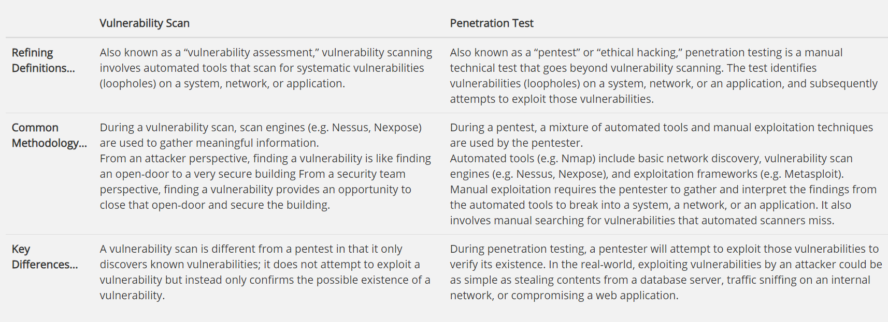
VA vs PT

Slide 6
Pro of VAPT
Provides enterprises with a more comprehensive application evaluation than any single test alone.
Gives an organization a more detailed view of the threats facing its applications, to protect from malicious attacks.
Helps identify programming errors
Provides a methodical approach to risk management

Slide 7
Why are systems vulnerable?
Two main reasons for systems being vulnerable
Misconfiguration
Incorrect programming practices.

Slide 8
Network misconfiguration
Devices such as routers, switches and servers, as well as firewalls and IPS systems are either misconfigured
As an example, almost all firewalls have a default built-in user account with the name,‘admin’.
Typically, the password for it is also set to ‘admin,’ by default, or something even easier to guess.
In Some cases, not configured at all, thus running default settings.

Slide 9
Incorrect programming practices
User input taken from a Web application form may be directly sent to a backend database server without parsing it.
e.g. Can lead to a parameter manipulation attack or SQL injection attack.
E.g. of programming errors would be a Web service accepting requests without performing adequate authentication
Human error

Slide 10
VAPT
Web VAPT
Network VAPT
VAPT
Websites are vulnerable
Simulation of real life hacking methodologies.
Networks, systems, hosts and network devices (i.e. routers, switches)
Unauthorized access to sensitive data

Slide 11
Exploit Categories
Web server exploits
Web service exploits
Authentication problems
Configuration problems
Database related problems
Scripting related problems

Slide 12

Case Study
Google Search- BJP website got hacked before elections as VPN credentials were floated online by one minister which were used for hacking website later by attackers
https://www.saddahaq.com/after-advanis-website-gets-hacked-bjp-blocks-its-website-access-in-pakistan

Slide 13
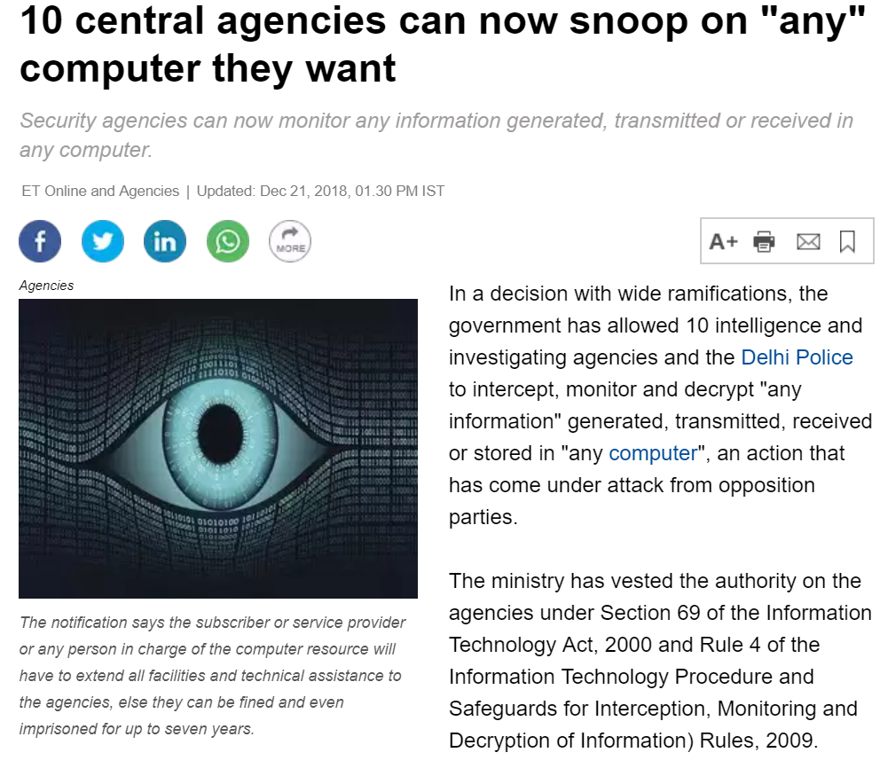
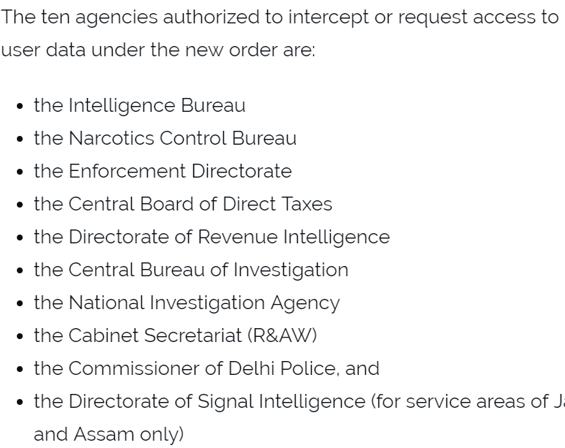
10 organisations monitoring intercepting on internet in India 2019

Slide 14
PENETRATION TESTING

Slide 15
5 phases of Penetration Testing
There are 5 Phases which depicts how to gain access of a system.
1. INFORMATION GATHERING (Reconnaissance)
2. SCANNING (OS, IP, MAC etc)
3. GAINING ACCESS-(Exploitation/Weaponization)
4. MAINTAINING ACCESSS-(Persistence)
5. COVERING TRACES-(Logs/events)
Pre-Attacking Phase
Attacking or Exploitation Phase
Post Exploitation Phase

Slide 16
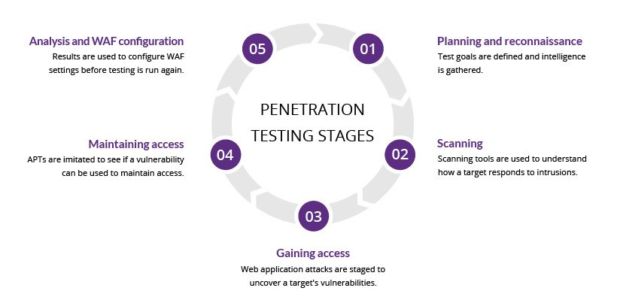
PenTesting

Slide 17
Types of Penetration Testing
The types of penetration testing can vary depending on the technology.
Network Testing
Mobile Application Testing
Web Application Testing
Cloud Testing
Social Engineering Testing
Even though each area of penetration testing have differing tool sets,
They share a common methodology
Here are some of the common types of pen testing:

Slide 18
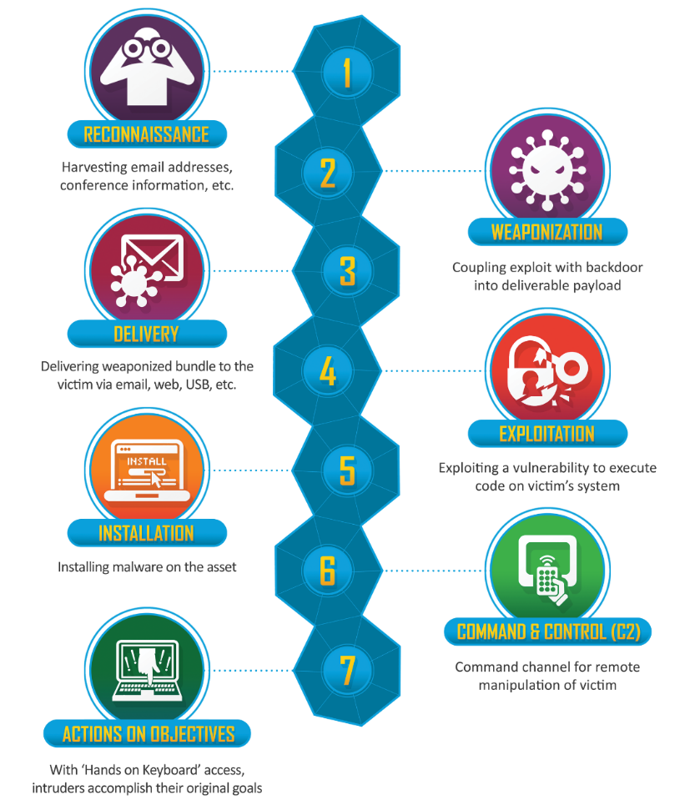
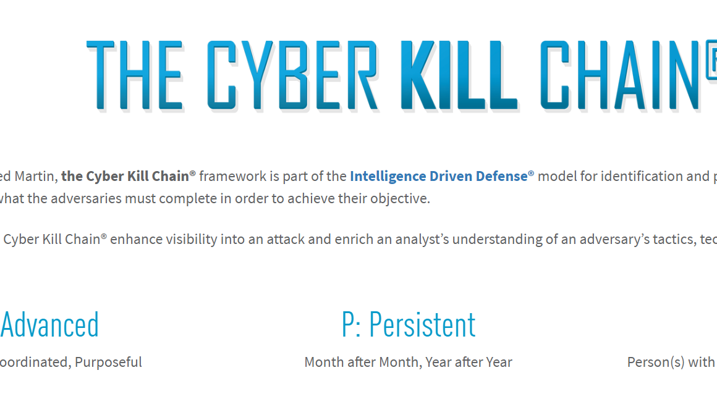
Lockheed Martin Kill Chain-it tells what all phases to work in for cyber security

Slide 19

Case Study
Attacker took .3 roubles from per user/month. Total users were 14.7 million
Total sum per day was 0.3x14.7 millions
Total salary per month =50 millions
Bank got to know after 1.6 years
Bank thought s/w glitch, then matched accounts on paper, it took time.
Attacker arrested after 3-4months later bank employed attacker and offered job of CISO highest position (22LPA)
Chief information security officer

Slide 20
NIST (National Institute of Standards and Technology)
NIST implements practical cybersecurity and privacy through outreach and effective application of standards and best practices necessary for the U.S. to adopt cybersecurity capabilities.
(https://www.nist.gov/topics/cybersecurity)
1805 profiles for jobs

